Slide 1

Academic Session 2025-26
Even Semester Jan-May 2026
UNIVERSITY INSTITUTE OF ENGINEERING
AIT-CSE (AIML)
CS221: B.E. CSE (AIML)
6th Semester
Artificial Intelligence
(23CSH-378)
Unit No. 1 Chapter No. 1.2 Lecture No. 6 to 10
Topic : Search Strategies in AI
Dr. Prabhjot Kaur (E16646) Assistant Professor

Slide 2
COURSE OBJECTIVES
1
The course aims to:
To develop an architecture and components of expert systems and distinguish them from conventional programming approaches.
To apply knowledge representation and knowledge acquisition techniques for designing intelligent and rule-based systems.
To explain inference mechanisms and explanation systems used in expert systems for effective decision making.
To understand AI planning approaches, including classical, hierarchical, and multi-agent planning for real-world problem solving.
To explore AI applications in robotics and computer vision, including path planning, obstacle avoidance, object detection, and SLAM using OpenCV.

Slide 3

COURSE OUTCOMES
2
On completion of this course, the students shall be able to:
CO1 | Recall the fundamental concepts of AI, including intelligent agents, problem-solving approaches, and search strategies.
CO2 | Illustrate the various search techniques, including uninformed and heuristic-based methods, to solve AI-related problems.
CO3 | Implement rule-based systems using forward and backward chaining for decision-making and learning.
CO4 | Analyze and evaluate different knowledge representation techniques, logic programming, and reasoning methods in AI.
CO5 | Design and implement uncertainty handling techniques, including probabilistic reasoning, fuzzy logic, and Bayesian networks.

Slide 4
Unit-I Syllabus
3
Unit-1 | Regression | Contact Hours: 15
Introduction to AI | Introduction, AI problems, foundation of AI and history of AI intelligent agents: Agents and Environments, the concept of rationality, the nature of environments, structure of agents, problem solving agents, problem formulation.
Search Strategies in AI | State Space Representation, uniformed search strategies – Breadth first search, depth first Search. Informed Search Strategies (Heuristic search) Hill climbing, A*, AO* Algorithms, Problem reduction, Constraint Satisfaction Problems (CSP)
Game Playing and Adversarial Search | Introduction, Adversarial Search Algorithms: Mini-Max Algorithm, Optimal Strategies for Game Playing, Alpha-Beta Pruning (Optimization of Mini-Max),Move Ordering and Efficiency Improvements, Game Trees and State Representation, Real-World Applications of Game AI
Self-Study | Backtracking, local search, and arc consistency techniques, Designing heuristics for strategic decision-making, Probabilistic decision-making in game AI

Slide 5
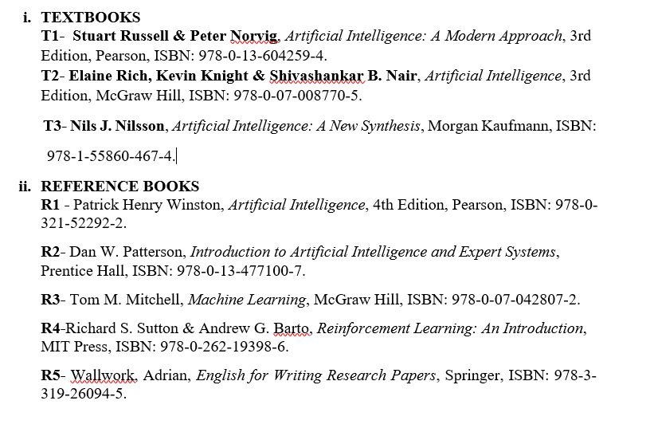
SUGGESTIVE READINGS
4

Slide 6
Table of Contents
5
State Space Representation
Uniformed search strategies (BFS,DFS)
Informed Search Strategies (Heuristic search)
A*, AO* Algorithms
Problem reduction
Constraint Satisfaction Problems (CSP)

Slide 7

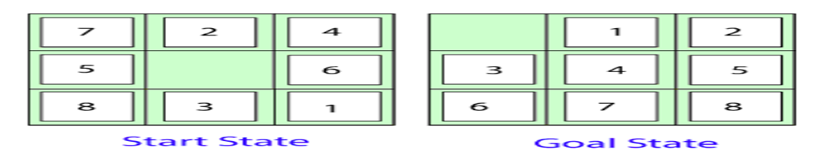
State Space Representation:
State space is the set of all possible states from the initial state to the goal state through valid operations.
Components:
Initial State
Goal State
Operators
State Space Graph
Path Cost

Slide 8
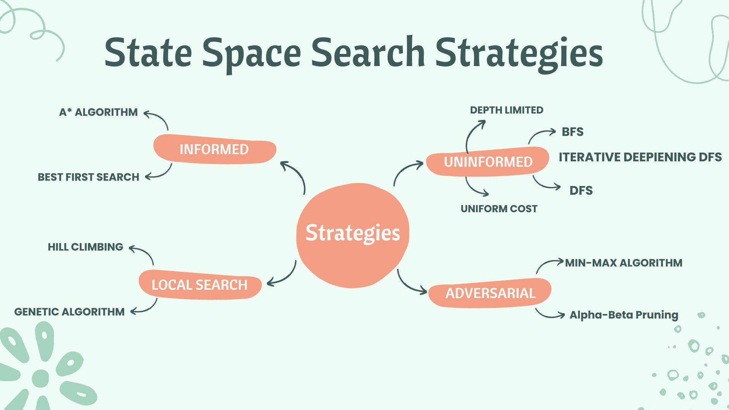

Slide 9
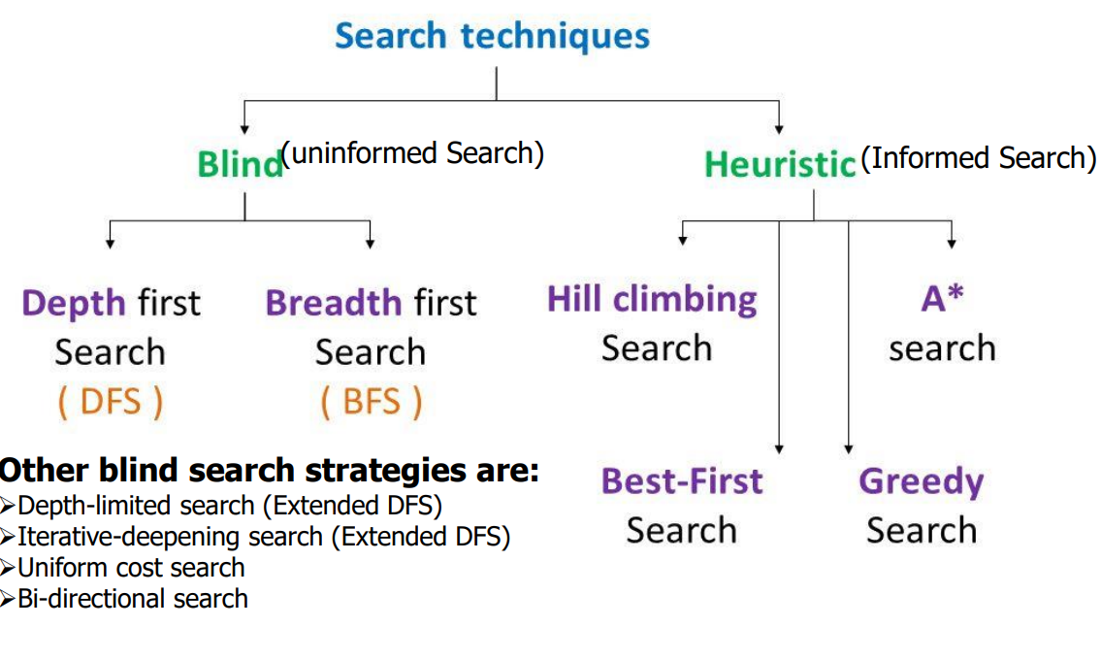

Slide 10
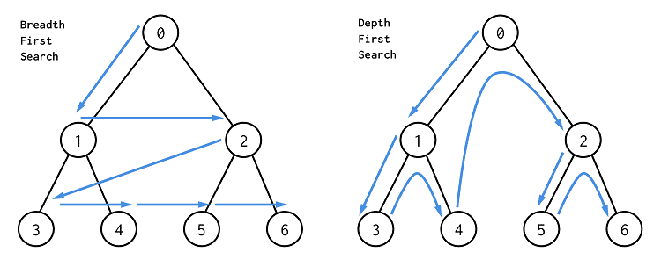
Uninformed Search:
Search without using extra problem knowledge.
Type:
Breath First Search
Depth First Search
In AI, BFS is complete and optimal but memory-expensive, while DFS is memory-efficient but not reliable.

Slide 11
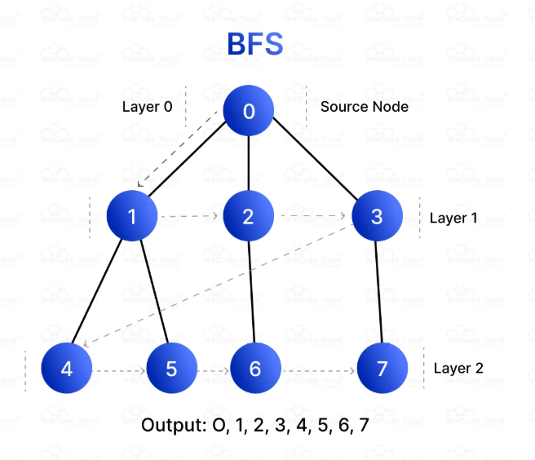
BFS – BREADTH FIRST SEARCH
Definition:
Explores all nodes at current depth before going deeper. (Shallowest node)
Uses:
✔ Guaranteed solution
✔ Finds shortest path

Slide 12
BFS (Cont.…)
Explores the state space level-by-level
Uses Queue (FIFO) as frontier list
Guarantees finding a solution if one exists (Complete)
Finds optimal solution when step cost is uniform
Requires very high memory for large state spaces
Not suitable when branching factor is large
Good for problems where solution depth is small
Common AI uses:
--Shortest path problems
--Robot navigation in grids
--Puzzle problems

Slide 13

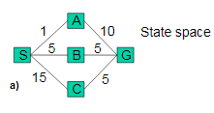
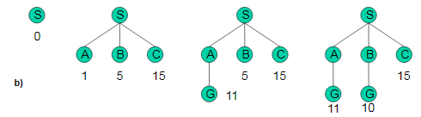
Uniform-cost search
• Modified breadth-first, expands only the node with the least cost (using path g(n)).
• Breadth-first = uniform-cost search with g(n)=depth(n).
Problem: from S to G, costs are marked (a). SAG is first solution (cost 11).
The algorithm does not recognize this as solution, because 11 > 5 from B). SBG as final solution (b).

Slide 14
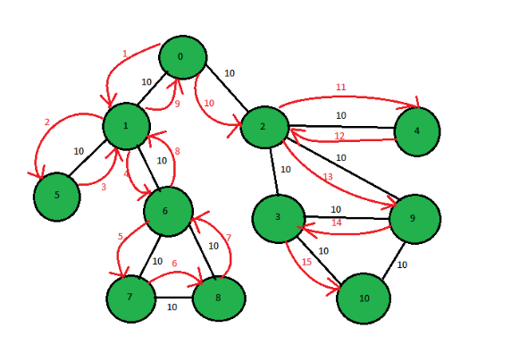
DFS – DEPTH FIRST SEARCH
Definition:
Explores deepest node first. If a node has no further children or leads to a dead-end, the algorithm backtracks to the nearest ancestor and explores remaining unvisited paths.
Advantages:
✔ Low memory
✔ Fast in deep problems

Slide 15
DFS(Cont.…)
Explores the state space depth-wise
Uses Stack / Recursion
Not guaranteed to find solution (Incomplete for infinite spaces)
Does not guarantee optimal solution
Requires very little memory
Efficient when solution depth is unknown
Can get trapped in loops
Common AI uses:
--Game tree search
--Backtracking problems
--Constraint solving

Slide 16
DFS vs BFS
When to Use BFS:
Shortest Path in Unweighted Graphs:
Shallow/Wide Graphs:
Minimum Moves or Steps: (e.g., puzzles like Word Ladder) are better solved with BFS.
When to Use DFS:
Exploring All Paths: (such as in maze solving)
Backtracking Problems: (like solving puzzles

Slide 17
Informed Search Strategies
Uses additional information called heuristics.
Heuristic Function:
h(n) = estimated cost to goal
Examples:
Distance in GPS
Tiles misplaced puzzle
Informed search uses problem-specific knowledge (heuristics) to guide the search toward the goal efficiently.
Unlike uninformed search, it makes intelligent decisions about which node to explore next instead of exploring blindly.

Slide 18
What is a Heuristic Function h(n)?
A heuristic function estimates the cost from node n to the goal state.
Examples:
Straight line distance in maps
Number of misplaced tiles in 8-puzzle
Evaluation function in games
AI algorithms select nodes using: f(n) = g(n) + h(n)
where:
g(n) = actual cost from start
h(n) = estimated cost to goal
f(n) = total estimated cost

Slide 19
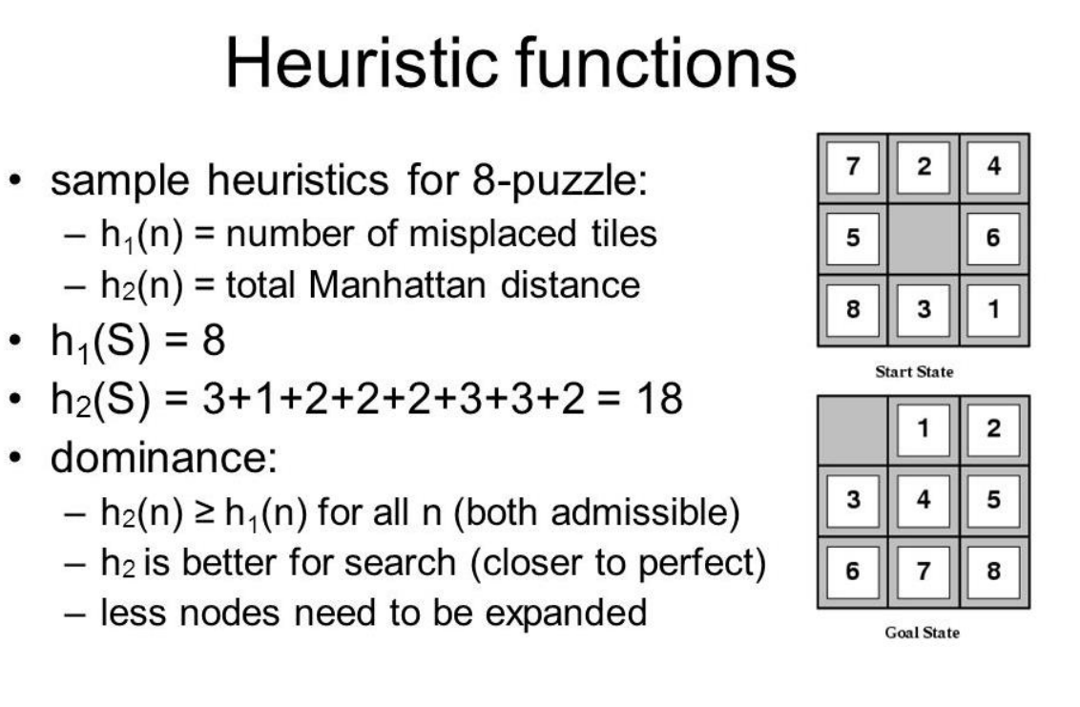
Notes:
Artificial Intelligence is composed of two words Artificial and Intelligence, where Artificial defines "man-made," and intelligence defines "thinking power", hence AI means "a man-made thinking power.“
Artificial Intelligence exists when a machine can have human based skills such as learning, reasoning, and solving problems
Eight definitions of AI, laid out along two dimensions. The definitions on top are concerned with thought processes and reasoning, whereas the ones on the bottom address behavior. The definitions on the left measure success in terms of fidelity to human performance, whereas RATIONALITY the ones on the right measure against an ideal performance measure, called rationality. A system is rational if it does the “right thing,” given what it knows.
THE FOUNDATIONS OF ARTIFICIAL INTELLIGENCE
Philosophy • Can formal rules be used to draw valid conclusions? • How does the mind arise from a physical brain? • Where does knowledge come from? • How does knowledge lead to action?
Mathematics • What are the formal rules to draw valid conclusions? • What can be computed? • How do we reason with uncertain information?
Economics • How should we make decisions so as to maximize payoff? • How should we do this when others may not go along? • How should we do this when the payoff may be far in the future?
Neuroscience • How do brains process information?
Psychology • How do humans and animals think and act?
Computer engineering • How can we build an efficient computer?
Control theory and cybernetics • How can artifacts operate under their own control?
Linguistics • How does language relate to thought?

Slide 20
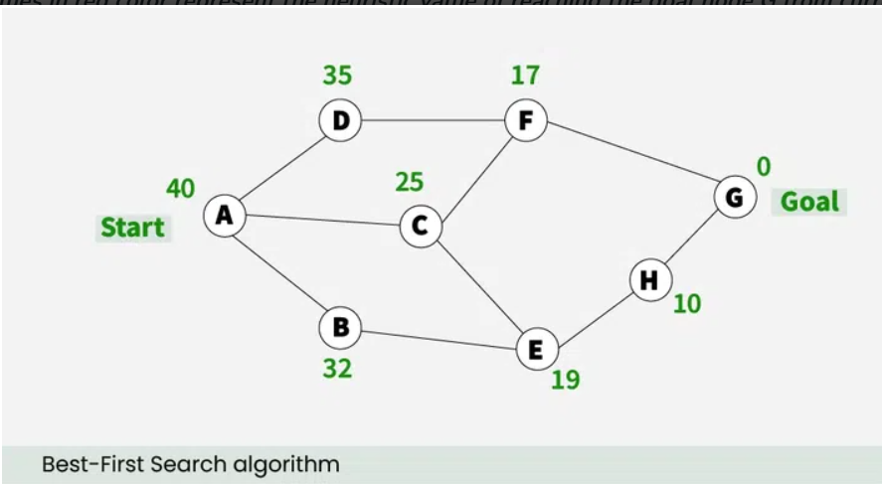
Greedy Best first search algorithm
An AI search algorithm that attempts to find the most promising path from a given starting point to a goal.
It prioritizes paths that appear to be the most promising, regardless of whether or not they are actually the shortest path.
This process is repeated until the goal is reached.

Slide 21
The performance measure of Best-first search Algorithm:
Completeness: Best-first search is incomplete even in finite state space.
Optimality: It does not provide an optimal solution.
Best first searches combines the advantage of BFS and DFS to find the best solution.
Advantages:
✔ Fast
✔ Simple
Disadvantages of Best-first search
BFS does not guarantees to reach the goal state.
Since the best-first search is a greedy approach, it does not give an optimized solution.
It may cover a long distance in some cases.

Slide 22
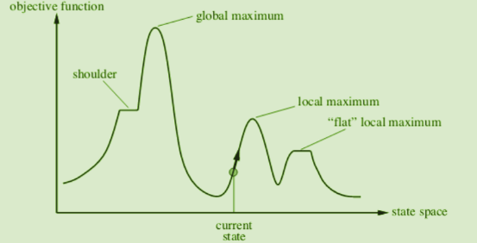
Hill Climbing
A local search strategy:
  Starts at an initial state, moves to neighbor with best improvement
Types: Simple, Steepest-Ascent, and Stochastic
Drawbacks:
  Gets stuck in local maxima, plateaus, or ridges

Slide 23
Hill Climbing( Cont..)
It Is a variant of the generate-and-test algorithm It makes use of
the greedy approach This means it keeps generating possible solutions until it finds the expected solution, and moves only in the direction which optimizes the cost function for it.
Types of Hill Climbing in AI
Simple Hill Climbing- This examines one neighboring node at a time and selects the first one that optimizes the current cost to be the next node.
Steepest Ascent Hill Climbing This examines all neighboring nodes and selects the one closest to the solution state.
Stochastic Hill Climbing- This selects a neighboring node at random and decides whether to move to it or examine another.

Slide 24
Problems in different regions in Hill climbing
Hill climbing cannot reach the optimal/best state(global maximum) if it enters any of the following regions :
Local maximum: At a local maximum all neighboring states have a value that is worse than the current state. Since hill-climbing uses a greedy approach, it will not move to the worse state and terminate itself. The process will end even though a better solution may exist.
- To overcome the local maximum problem: Utilize the backtracking technique. Maintain a list of visited states. If the search reaches an undesirable state, it can backtrack to the previous configuration and explore a new path.
Plateau: On the plateau, all neighbors have the same value. Hence, it is not possible to select the best direction.
-To overcome plateaus: Make a big jump. Randomly select a state far away from the current state. Chances are that we will land in a non-plateau region.
Ridge: Any point on a ridge can look like a peak because movement in all possible directions is downward. Hence the algorithm stops when it reaches this state.
- To overcome Ridge: In this kind of obstacle, use two or more rules before testing. It implies moving in several directions at once.

Slide 25
Algorithm for simple hill climbing.
Evaluate initial state- if goal state, stop and return success. Else, make initial state current.
Loop until the solution reached or until no new operators left to apply to current state:
a. Select new operator to apply to the current producing new state.
b. Evaluate new state:
If a goal state, stop and return success.
If better than the current state, make it current state, proceed.
Even if not better than the current state, continue until the solution reached.
Exit.

Slide 26
A* Search Algorithm
A* search is the most widely used informed search algorithm where a node n is evaluated by combining values of the functions g(n)and h(n). The function g(n) is the path cost from the start/initial node to a node n and h(n) is the estimated cost of the cheapest path from node n to the goal node. Therefore, we have
f(n)=g(n)+h(n)
where f(n) is the estimated cost of the cheapest solution through n.
Note: A* is optimal and complete but requires high memory and a good heuristic.

Slide 27
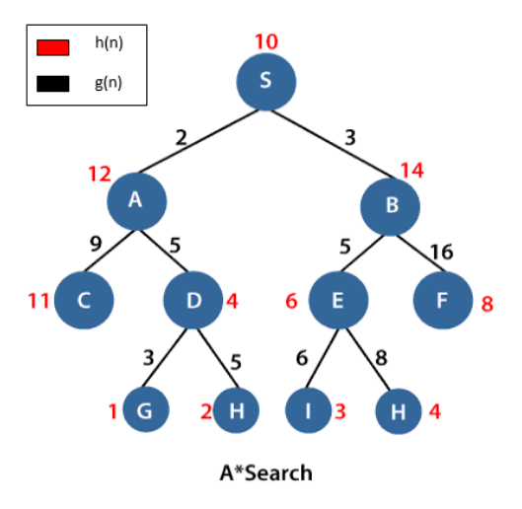
A* (Cont..)
S is the root node, and G is the goal node. Starting from the root node S and moving towards its next successive nodes A and B. In order to reach the goal node G, calculate the f(n) value of node S, A and B using the evaluation equation i.e.
f(n)=g(n)+h(n)
Calculation of f(n) for node S:
f(S)=(distance from node S to S) + h(S)
0+10=10.
Calculation of f(n) for node A:
f(A)=(distance from node S to A)+h(A)
2+12=14
Calculation of f(n) for node B:
f(B)=(distance from node S to B)+h(B)
3+14=17
Therefore, node A has the lowest f(n) value. Hence, node A will be explored to its next level nodes C and D and again calculate the lowest f(n) value. After calculating, the sequence we get is S->A->D->G with f(n)=13(lowest value)

Slide 28
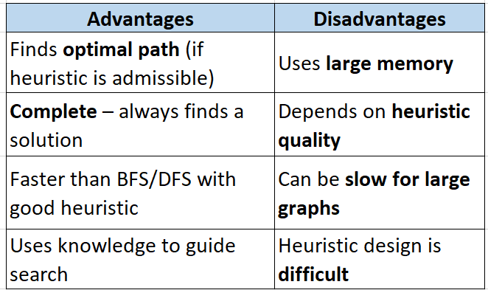
Performance measure of A* search:
- Completeness: The star(*) in A* search guarantees to reach the goal node.
- Optimality: An underestimated cost will always give an optimal solution.

Slide 29
Problem Reduction
Problem Reduction is the technique of breaking a large complex problem into smaller sub-problems, solving each one independently, and then combining their solutions to solve the original problem.
Why is Problem Reduction Needed?
Simplifies complex problems
Reduces computational cost
Improves clarity and design
Helps in systematic reasoning
Used in planning & expert systems
STEP-BY-STEP PROCESS
Identify main goal
Divide into sub-goals
Solve sub-goals individually
Combine results
Obtain final solution
Problem reduction is implemented through AND-OR graphs.

Slide 30
AO* Algorithm
AO* (And–Or Star) is a graph search algorithm used for problems that can be represented as AND–OR graphs instead of simple paths.
It’s a generalization of the A* algorithm — but while A* searches for the shortest path in a simple graph, AO* can find an optimal solution subgraph in problems where:
Some nodes require all of their children to be solved (AND nodes).
Some nodes require only one child to be solved (OR nodes).
This is useful for problem decomposition (breaking problems into sub problems).

Slide 31
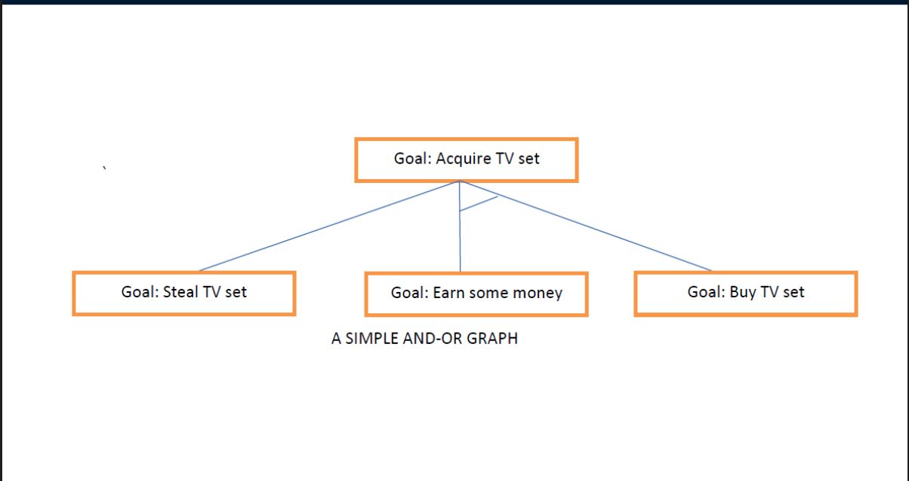
AO*(Cont..)
USED in:
Planning systems
Problem reduction tasks
Game playing with complex goals
Natural language parsing
Diagnosis systems

Slide 32
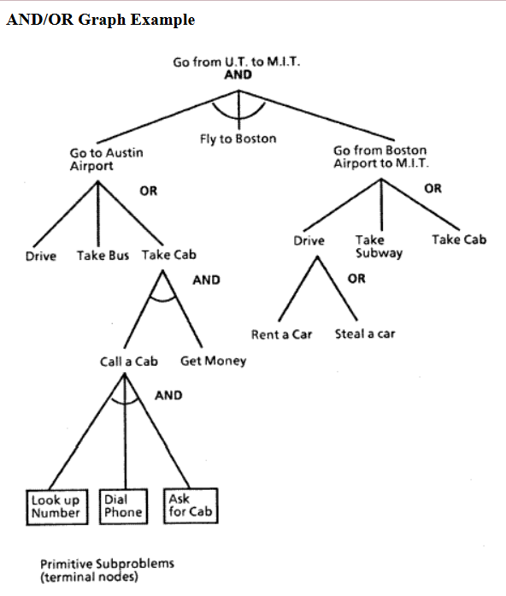

Slide 33
AO*(Cont..)
AO* is a graph search algorithm used for solving AND–OR graphs (problems that can be broken into sub problems where some are “AND” conditions and others are “OR” choices).
OR node → you can choose one of the branches.
AND node → you must solve all sub-branches together.
AO* tries to find the least-cost solution graph, not just a single path.
It is a generalization of A* for problems where solutions may require solving multiple sub problems in parallel.
AND nodes: All successors must be solved to solve the node. (e.g., a task that needs both Step A and Step B done)
OR nodes: Only one successor needs to be solved.
(e.g., choosing either Route A or Route B)
Cost: Like A*, cost g(n) + heuristic estimate h(n).

Slide 34
Constraint Satisfaction Problem
A Constraint Satisfaction Problem (CSP) is a mathematical problem in AI where:
The system must assign values to variables
Without violating any restrictions (constraints)
--A solution satisfies all constraints.
Example:
1. Map Coloring
Variables = Regions
Domain = Colors
Constraints = Neighboring regions cannot have same color
2. Sudoku
Variables = Empty cells
Domain = {1 to 9}
Constraints = No repetition per row, column, grid
In AI, a CSP finds values for variables that satisfy all given constraints using systematic search and pruning techniques.

Slide 35
SIMPLE CSP SOLVING TECHNIQUES
1) Backtracking Search : Try values one by one → go back if conflict.
2) Forward Checking :Remove invalid values from future variables early.
3) Arc Consistency (AC-3) :Ensure that every value in variable has valid support.
4) Constraint Propagation :Spread restrictions across all variables.

Slide 36
Summary of the Lecture
State Space Representation: AI problems are modelled as states, actions, initial state, and goal state.
Uninformed Search (BFS & DFS): Uninformed search explores the state space without using any domain knowledge or heuristics, relying only on problem structure.
Informed Search (Heuristic): Uses knowledge (h(n)) to guide search toward goal efficiently.
Hill Climbing: Selects best neighbouring state but may get stuck at local maxima.
A* Algorithm: Uses f(n)=g(n)+h(n) for optimal and complete search with good heuristic.
AO* Algorithm: Works on AND-OR graphs and solves problems by decomposition.
Problem Reduction: Breaks complex problem into smaller sub-tasks using AND-OR structure.
Constraint Satisfaction Problem (CSP): Solves problems using variables, domains, and constraints.

Slide 37
Next Lecture
In next lecture, we are going to cover:
Game Playing and Adversarial Search
Adversarial Search Algorithms: Mini-Max Algorithm,
Optimal Strategies for Game Playing,
Alpha-Beta Pruning (Optimization of Mini-Max)
Real-World Applications of Game AI

Slide 38
Quiz/ FAQ’s
41
What do you mean by AI? Discuss its advantages and disadvantages.
Explain 3 main applications of AI in Current era.
Explain the difference between strong AI and weak AI.
Describe the Turing Test and its relevance to AI.
Identify real-world problems that can be solved using AI.
Illustrate how AI differs from conventional programming.
Compare AI with human intelligence in terms of reasoning and learning.
Critique the feasibility of achieving general AI.
Justify the importance of AI in the modern technological world.

Slide 39
Faculty-curated videos, NPTEL, Coursera, LinkedIn, or other relevant learning resources
43
https://nptel.ac.in/courses/106106126
https://nptel.ac.in/courses/106105077
https://nptel.ac.in/courses/106106139
https://www.coursera.org/learn/ai-for-everyone
https://www.coursera.org/learn/machine-learning
https://www.coursera.org/learn/ai-search
https://inst.eecs.berkeley.edu/~cs188/
https://cs221.stanford.edu/

Slide 40

11
Class-Wise Feedback

Slide 41
Thank You
For queries
Email: Prabhjot.e16646@cumail.in

